Slide 1


Predict Saturated Thickness using TensorBoard Visualization
Authors: Vinh The Nguyen (vinh.nguyen@ttu.edu), Tommy Dang (tommy.dang@ttu.edu)
Presenter: Vinh The Nguyen PhD student
Computer Science Department
Texas Tech University, Lubbock, TX, USA
June 4, 2018

Slide 2
CONTENTS
Introduction
Related Work
Methodology
Demo
Open question and Discussion

Slide 3
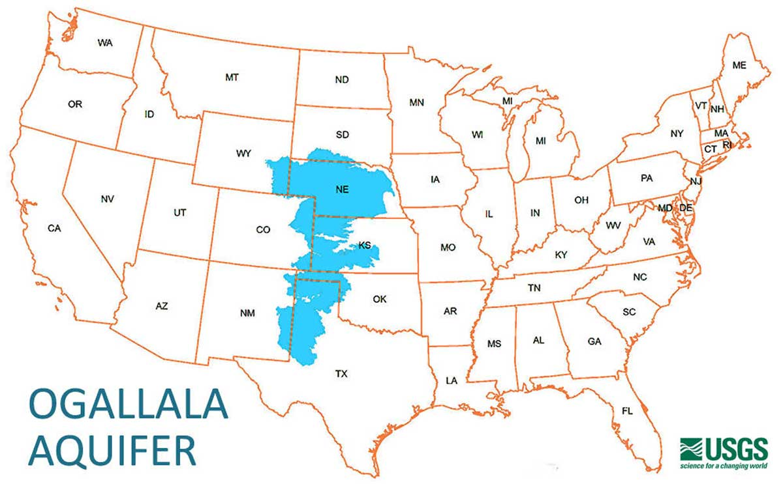
INTRODUCTION
FACTS:
One of the world's largest aquifers
Approximately 174,000 square miles
In portions of eight states
Provide water for drinking,
Irrigation, manufacturing activities…
for nearby the boundaries of the Ogalla
Aquifer.

Slide 4
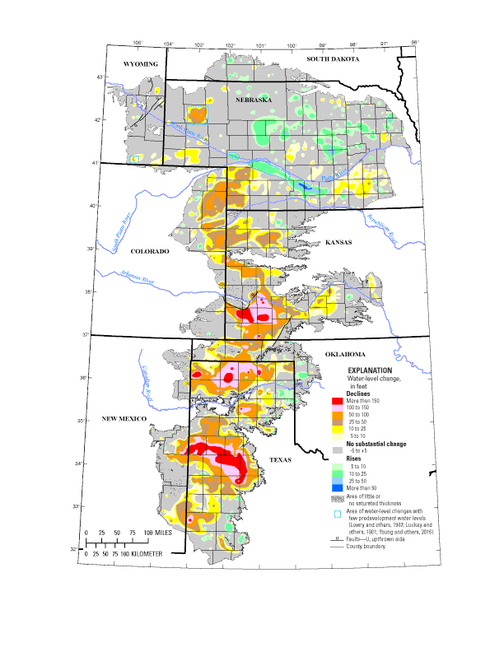
INTRODUCTION
Problem:
Over extraction
Pollution
The water level has declined significantly since 1950
Source: USGS SIR 2017-5040

Slide 5
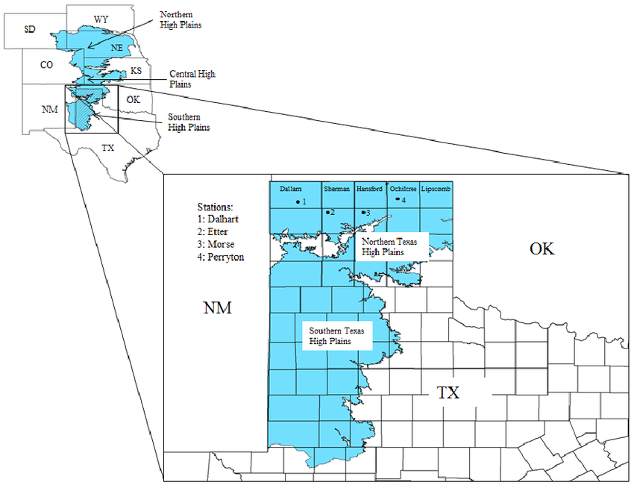
INTRODUCTION
Focus study:
Ogallala Aquifer in
High Plains region Texas
Source: Use of Crop-Specific Drought Indices for Determining Irrigation Demand in the Texas High Plains

Slide 6
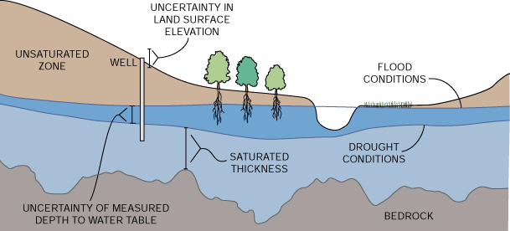
INTRODUCTION
Saturated Thickness:
“the difference in elevation (or depth) between the water table and the bedrock surface”
Source: http://www.kgs.ku.edu/HighPlains/atlas/apst.htm

Slide 7
INTRODUCTION
RESEARCH QUESTIONS:
1. How can we predict the saturated thickness of the Ogalla Aquifer next month for proper water management strategies for a sustainable use of the
aquifer system ?
2. How can we understand the prediction model w.r.t non-expert in machine learning?
Source: http://www.kgs.ku.edu/HighPlains/atlas/apst.htm

Slide 8
RELATED WORK
Dutton et al. Saturated Thickness in the Ogallala Aquifer in the Panhandle Water Planning Area— Simulation of 2000 through 2050 Withdrawal Projections
-> a conceptual model that was capable of predicting underground water levels of 18 counties in Texas by 2050.
-> based on the assumptions that pumping remains constant until a well is depleted and projected pumping rates were based on the continuation of agriculture and economic development.
2. A lot of other studies tried to use different prediction models (Auto-Regressive (AR), Moving Average (MA), or Auto-Regressive Integrated Moving Averages (ARIMA)…) and compare the performance of these models without looking into detail of these model visually.

Slide 9
METHODOLOGY
Our approach:
We employ the Long-Short Term Memory (LSTM) model based on Keras API to predict the saturated thickness.
Why LSTM: a type of recurrent neural network to predict future value based on history data. Why NOT other models? Study by Sima Siami-Namini showed the performance of LSTM with other models and proved that LSTM performed better. Time is matter
Why : Keras is a high-level neural networks API, written in Python and capable of running on top of TensorFlow, CNTK, or Theano. It was developed with a focus on enabling fast experimentation. Being able to go from idea to result with the least possible delay is key to doing good research.
2. We use TensorBoard visualization to analyze how the prediction model works, trace and debug data flow.
Why: Employ Keras API is easy, but how can we understand the model visually?

Slide 10
METHODOLOGY
What is Tensorflow ?
“TensorFlow is an open source software library for numerical computation using data-flow graphs. It was originally developed by the Google Brain Team within Google's Machine Intelligence research organization for machine learning and deep neural networks research”
What is Tensorgraph?
“…is a data structure that fully describes the computation you want to perform”

Slide 11
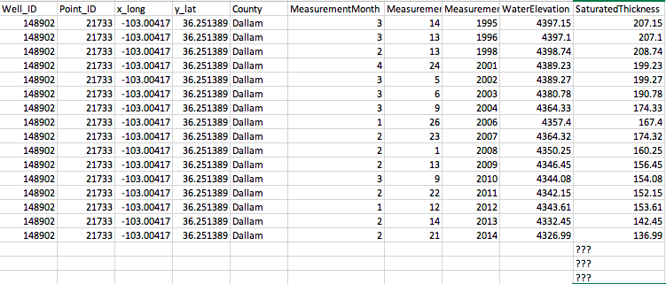
METHODOLOGY
Our dataset: How can we predict next month data given previous history??

Slide 12
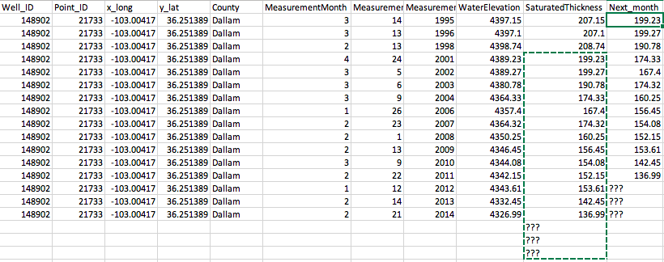
METHODOLOGY
Our approach: Shift data back to t_lookback month (in this case lookback = 3) then apply Machine learning to solve the problem

Slide 13
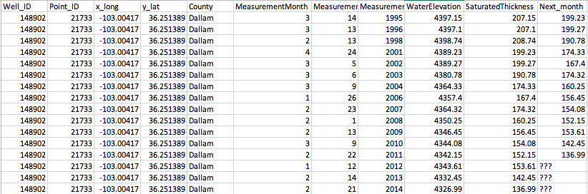
METHODOLOGY
Our approach: Shift data back to t_lookback month (in this case lookback = 3) then apply Machine learning to solve the problem
Notes:
Meaning that we need to train a model so that when we plug out input data, it will give the predicted value as close to the true value as possible. When we have new incoming data we can give the prediction that’s good enough

Slide 14
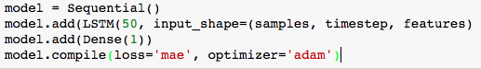
METHODOLOGY
Model construction: Thanks to KERAS API, setting up LTSM model for training data is simple with a few line of code.
Where:
Number of hidden neural: 50 (we can try with different values)
Samples: total records in our dataset
Timestep: lookback month
Features: Number of column for training
Loss: mean square error
Optimizer: adam - which is a method to minimize loss
Notes:
Meaning that we need to train a model so that when we plug out input data, it will give the predicted value as close to the true value as possible. When we have new incoming data we can give the prediction that’s good enough

Slide 15
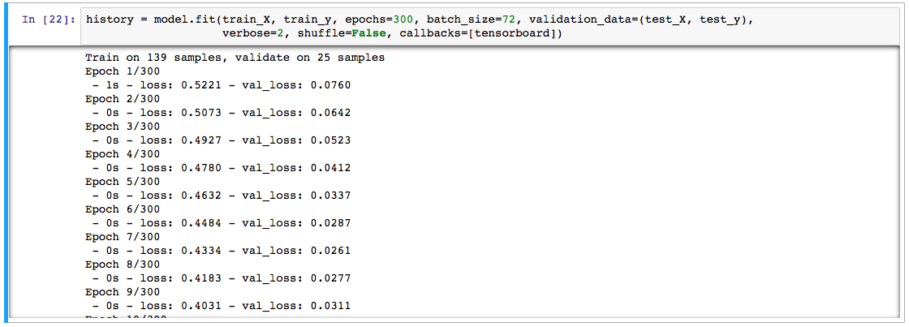
METHODOLOGY
When we train the model, we get the result like figure below. At the end of training, loss: 0.0040 - val_loss: 0.0048 => that seems a good result
Notes:
Meaning that we need to train a model so that when we plug out input data, it will give the predicted value as close to the true value as possible. When we have new incoming data we can give the prediction that’s good enough

Slide 16
METHODOLOGY
But the QUESTION is: What’s going on inside that algorithm?
Right now I have no idea why I achieve this result
Notes:
Meaning that we need to train a model so that when we plug out input data, it will give the predicted value as close to the true value as possible. When we have new incoming data we can give the prediction that’s good enough

Slide 17
METHODOLOGY
That’s the reason Why we need TensorBoard
to visualize the model
Notes:
Meaning that we need to train a model so that when we plug out input data, it will give the predicted value as close to the true value as possible. When we have new incoming data we can give the prediction that’s good enough

Slide 18
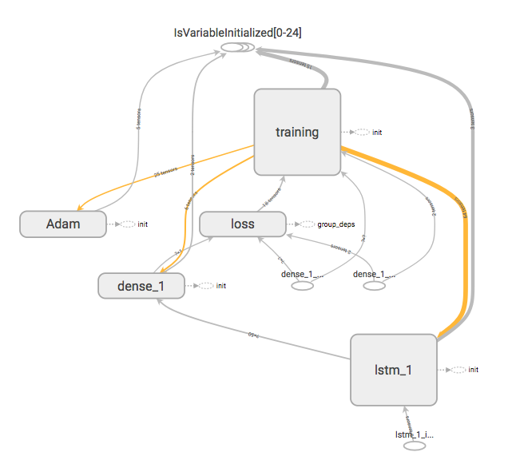
METHODOLOGY
By setting the writer:
tf.summary.FileWriter(”logs", sess.graph)
And activate tensorboard
Tensorboard –logdir logs
Then open browers:
http://localhost:6006 we have the tensorgraph as shown on the right figure

Slide 19
METHODOLOGY
The next question is:
HOW CAN I INTEPRET THIS GRAPH??
This is the main part of this presentation.
BUT before looking at this graph. I find it useful to go from a simple example first to get you started with Machine Learning and how to visualize an algorithm with Tensorgraph

Slide 20
METHODOLOGY
Simple prediction: given a set of feature, can you predict the target value?
Feature | Target
5 | 12
8 | ???
Solution: Finding weights
Target = 5 x weights => 12 = 5 * weight => weight = 12/5 = 2.4
Feature | Target
5 *weights = | 12
8 * weights = | 8*2.4 = 19.2

Slide 21
METHODOLOGY
Solution: Old approach
Target = 5 x weight => 13 = 5 * weight => weight = 13/5 = 2.6
But : 8*2.6 = 20.8 !=19
We need a bias or
Target = 5*weight + bias
Solving 5* weight + bias = 13 and 8*weight + bias = 19 => weight = 2, bias = 3
Simple prediction:
Feature | Target
5 | 13
8 | 19
7 | ???
Feature | Target
5 *weights + bias | 12
8 *weights + bias | 19
7 *weights + bias | 17 = 7*2 +3

Slide 22
METHODOLOGY
What happen if we need to solve ?????:
Feature | Target
5 | 13
8 | 19
7 | 18
5.5 | 15
7.5 | ???
Feature 1 | Feature 2 | Target
5 | 12 | 4
8 | 19 | 5
7 | 20 | 8.6
4 | 13 | 9
6 | 14 | ???

Slide 23
METHODOLOGY
This is when
MACHINE LEARNING SHINES

Slide 24
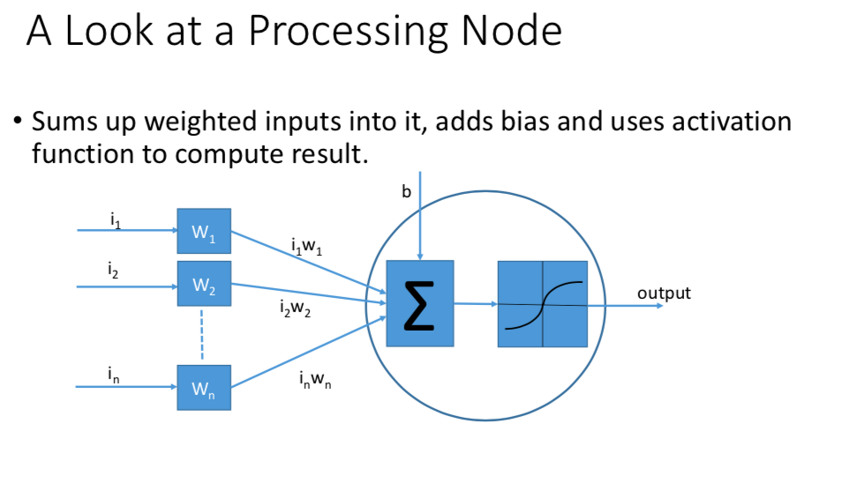
METHODOLOGY

Slide 25
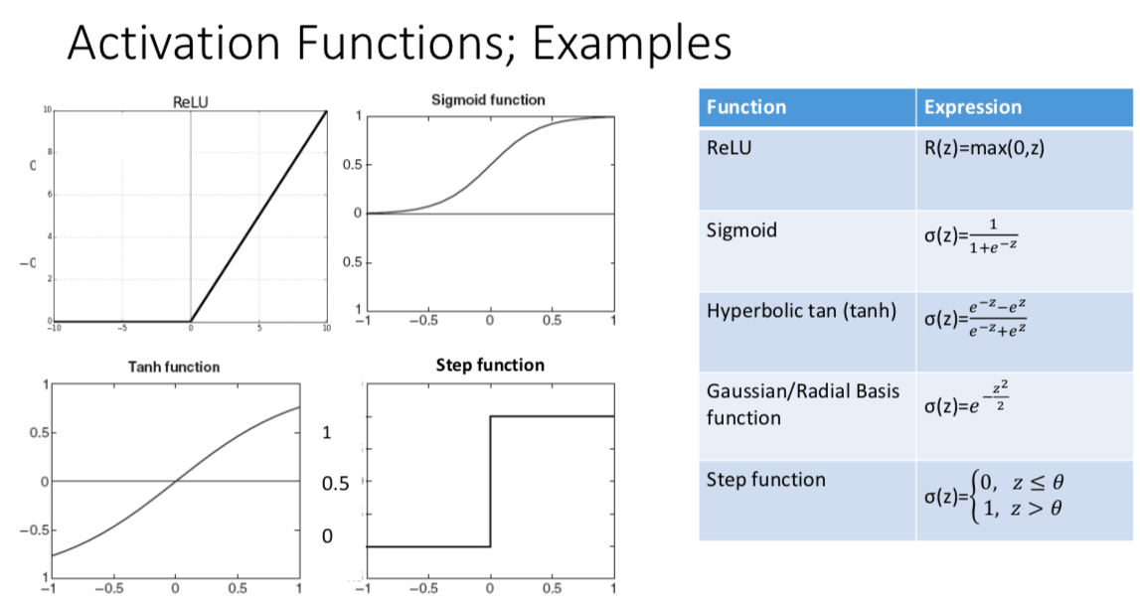
METHODOLOGY

Slide 26
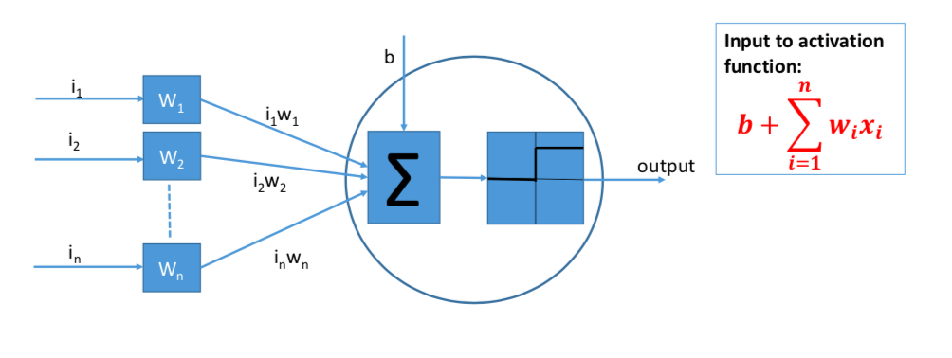
METHODOLOGY

Slide 27
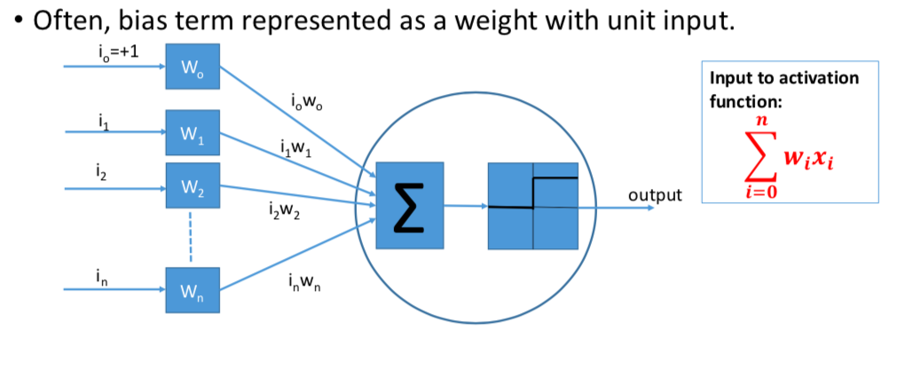
METHODOLOGY

Slide 28
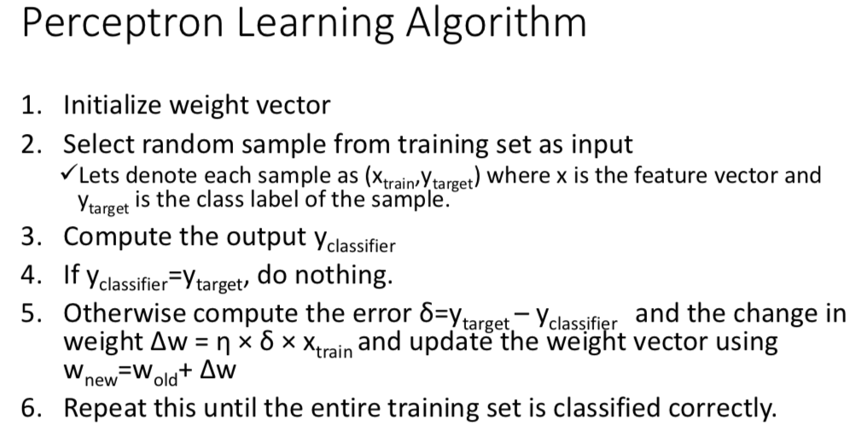
METHODOLOGY

Slide 29
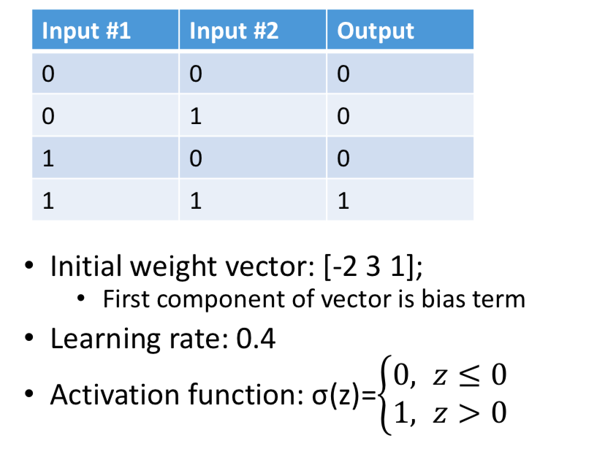
METHODOLOGY

Slide 30
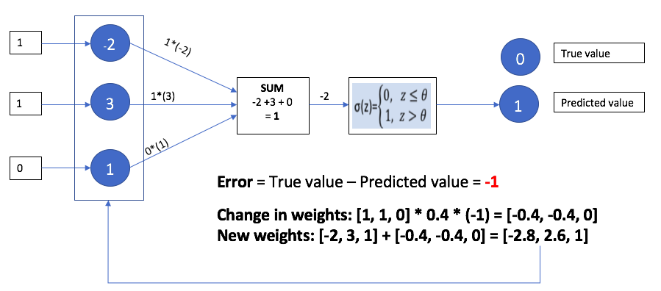
METHODOLOGY

Slide 31
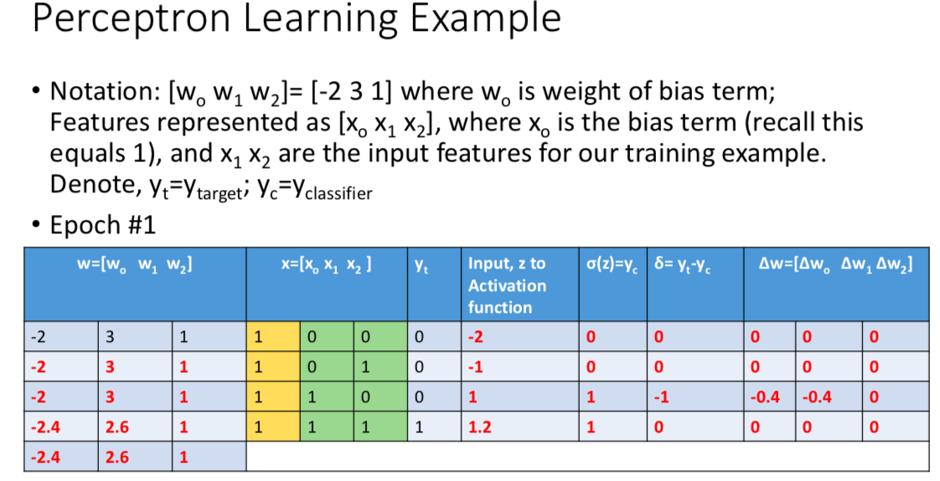
METHODOLOGY

Slide 32
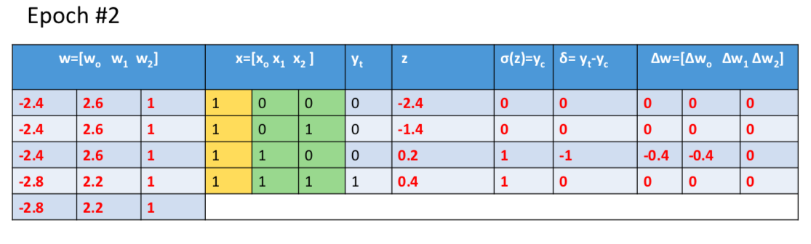
METHODOLOGY

Slide 33
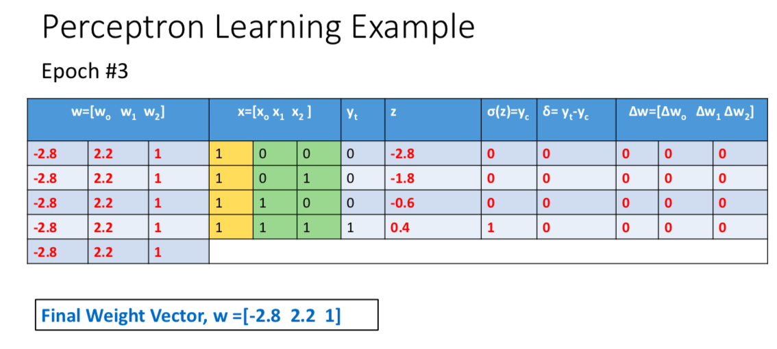
METHODOLOGY

Slide 34
METHODOLOGY
The QUESTION is:
How can we visualize our algorithm?
How do we know if one part of the algorithm was not wired up correctly

Slide 35
METHODOLOGY
TENSOR GRAPH: NODE AND EDGE
Each node represents operations
Data flows between nodes is called Tensor

Slide 36
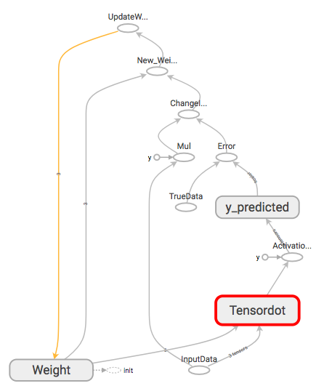
METHODOLOGY

Slide 37
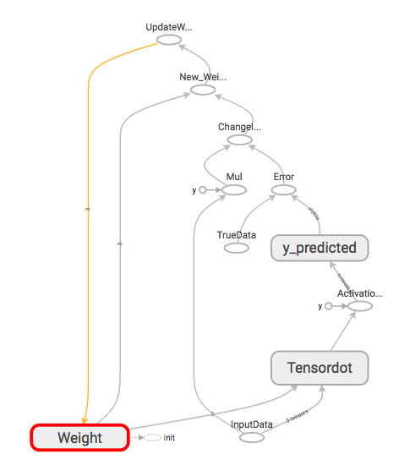
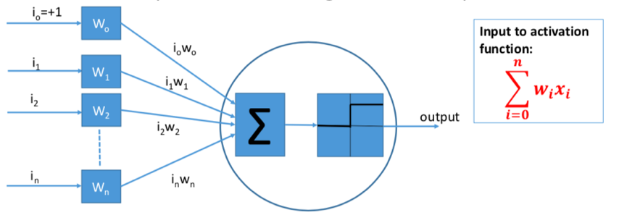
METHODOLOGY
1. Initialize weight vector

Slide 38
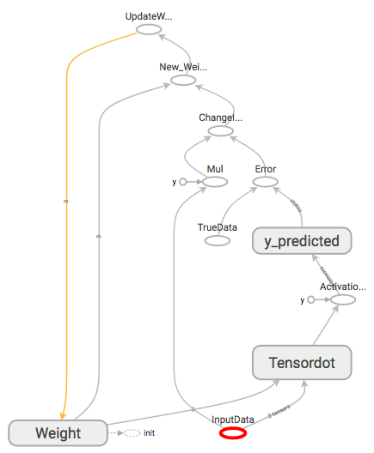
METHODOLOGY
2. Select sample from training input

Slide 39
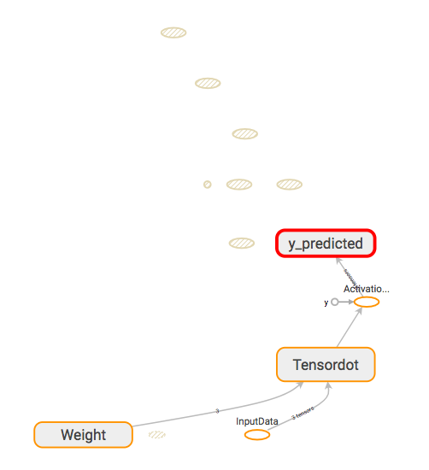
METHODOLOGY
3. Compute output y predicted

Slide 40
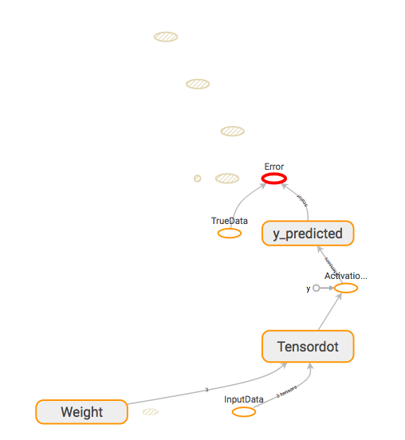
METHODOLOGY
4. Compute Error = True Value – Predicted value

Slide 41
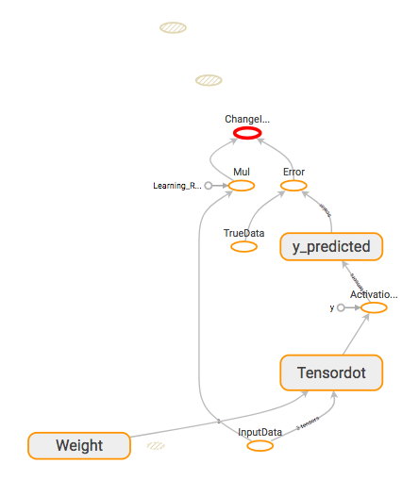
METHODOLOGY
4. Compute Error = True Value – Predicted value

Slide 42
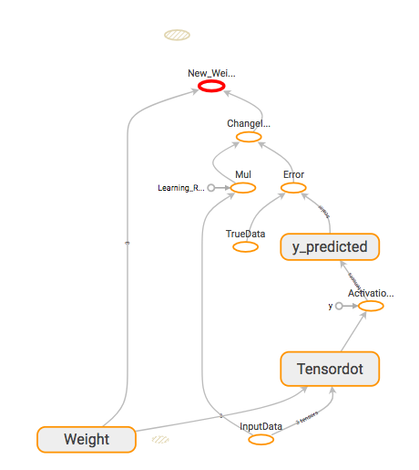
METHODOLOGY

Slide 43
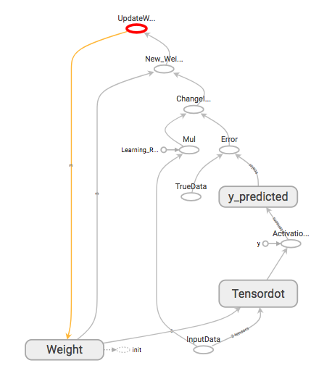
METHODOLOGY

Slide 44
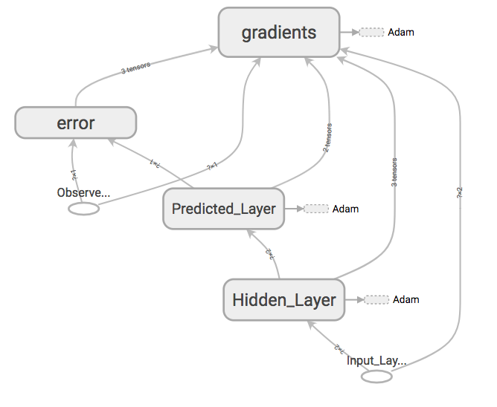
METHODOLOGY
For complex operations,
We often group operations into a container

Slide 45
METHODOLOGY
DEMO
Full documentation and video can be found at: https://github.com/Alex-Nguyen/SaturatedThicknessTensorBoard

